Slide 1
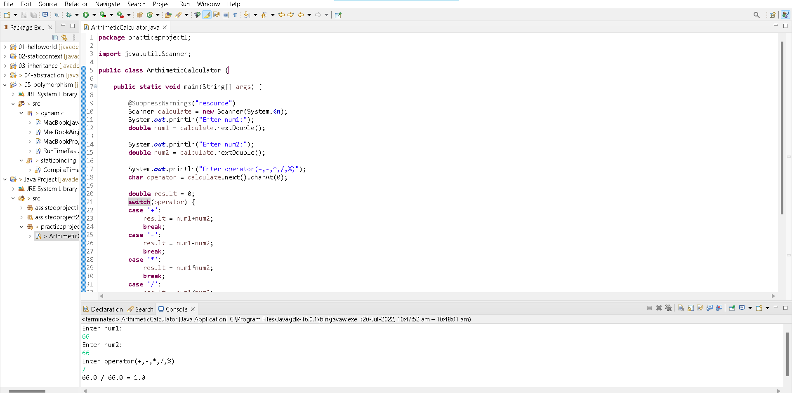
ARTHIMETIC CALCULATOR PROGRAM SCREENSHOTS

Slide 2
